Slide 1
CS2009 Design and Analysis of Algorithms
NP Completeness Chapter # 34

Slide 2


Polynomial-time?
Are they polynomial-time running time?
$T\left(n\right)=3$
yes
$T\left(n\right)=n$
yes
$T\left(n\right)=nlg\left(n\right)$
yes
$T\left(n\right)=n^{3}$
Yes
Polynomial-time: running time is $O(n^{k})$, where k is a constant.
$T\left(n\right)=5^{n}$
No
$T\left(n\right)=n!$
No

Slide 3
P and NP?
P problems
(The original definition) Problems that can be solved by deterministic Turing machine in polynomial-time.
(A equivalent definition) Problems that are solvable in polynomial time.
Problems with polynomial-time algorithms are considered as tractable
NP problems
(The original definition) Problems that can be solved by non-deterministic Turing machine in polynomial-time.
(A equivalent definition) Problems that are verifiable in polynomial time.
Given a solution, there is a polynomial-time algorithm to tell if this solution is correct.

Slide 4
P and NP?
Polynomial-time verification can be used to easily tell if a problem is a NP problem
E.g.:
Sorting, n-integers
A candidate: an array
Verification: scan it once
Max-heapify, n-nodes:
A candidate: a complete binary search tree
Verification: scan all the nodes once
Find all the sub sets of a given set A, |A|=n
A candidate: a set of set
Verification: check each set

Slide 5
P and NP?
Based on the definition of P and NP, which statements are correct?
“NP means non-polynomial”
No!
$P∩NP=∅$
No. $P⊆NP$
A P problem is also a NP problem
Yes. $P⊆NP$

Slide 6
P =? NP
any problem solvable by a deterministic Turing machine in polynomial time is also solvable by a nondeterministic Turing machine in polynomial time. Thus, P ⊆ NP
P = NP means whether an NP problem can belong to class P problem. In other words whether every problem whose solution can be verified by a computer in polynomial time can also be solved by a
computer in polynomial time

Slide 7
P =? NP
In order to prove that P ≠ NP, we would need to prove that there exists a set of problems X such that:
X falls in NP. There exists an algorithm with which a nondeterministic Turing machine could solve problems in X in polynomial time
X does not fall in P. There exists no algorithm whatsoever with which a deterministic Turing machine could solve problems in X in polynomial time

Slide 8
NP-complete problems
A NP-complete problem(NPC) is
a NP problem
harder than all equal to all NP problems
In other words, NPC problems are the hardest NP problems
So far, no polynomial time algorithms are found for any of NPC problems
However, “P is equal to NP or not” is currently unknown
But most of computer scientists do not believe N=NP
http://www.cs.uchicago.edu/~fortnow/papers/pnp-cacm.pdf

Slide 9
NP-complete problems
Most scientists believe:
However, it is not ruled out that:
NP
NP=NPC=P
NPC
P
NP-Hard problems: problems harder than or equal to NPC problems

Slide 10
Why we study NPC?
One of the most important reasons is:
If you see a problem is NPC, you can stop from spending time and energy to develop a fast polynomial-time algorithm to solve it.
Just tell your boss it is a NPC problem
How to prove a problem is a NPC problem?

Slide 11
Prove a problem is a NPC problem?
A common method is to prove that it is not easier than a known NPC problem.
To prove problem A is a NPC problem
Choose a NPC problem B
Develop a polynomial-time algorithm translate A to B
A reduction algorithm
If A can be solved in polynomial time, then B can be solved in polynomial time. It is contradicted with B is a NPC problem.
So, A cannot be solved in polynomial time, it is also a NPC problem.

Slide 12
What if a NPC problem needs to be solved?
Buy a more expensive machine and wait
(could be 1000 years)
Turn to approximation algorithms
Algorithms that produce near optimal solutions

Slide 13
Algorithmic Breakthrough
Team builds first living robots—that can reproduce
https://wyss.harvard.edu/news/team-builds-first-living-robots-that-can-reproduce/
Large language models
Exaone 300 Billion Parameters (https://analyticsindiamag.com/now-lg-brings-out-a-massive-language-model-can-tune-around-300-billion-variables/)
Gopher 280 Billion Parameters (https://deepmind.com/blog/article/language-modelling-at-scale)
GPT-3 (https://en.wikipedia.org/wiki/GPT-3)
Discovery of Exoplanets
366 discovered UCLA Algorithms (https://newsroom.ucla.edu/releases/astronomers-discover-300-new-exoplanets-gas-giants)
Quantum Communication Breakthrough by ISRO
ISRO Quantum Communication Breakthrough (https://analyticsindiamag.com/isro-quantum-communication-breakthrough-india-qkd/)
GitHub Copilot (https://copilot.github.com/)
OpenAI’s DALL·E Images from Text (https://openai.com/blog/dall-e/)
Meta’s SEER (SElf-supERvised) (https://towardsdatascience.com/self-supervised-learning-methods-for-computer-vision-c25ec10a91bd)

Slide 14
CS2009 Design and Analysis of Algorithms
Approximate Algorithms Chapter # 35

Slide 15
Approximation algorithms for NPC problems
If a problem is NP-complete, there is very likely no polynomial-time algorithm to find an optimal solution
The idea of approximation algorithms is to develop polynomial-time algorithms to find a near optimal solution

Slide 16
Approximation algorithms for NPC problems
E.g.: develop a greedy algorithm without proving the greedy choice property and optimal substructure.
Are those solution found near-optimal?
How near are they?

Slide 17
Approximation algorithms for NPC problems
Approximation ratio $ρ\left(n\right)$
Define the cost of the optimal solution as C*
The cost of the solution produced by a approximation algorithm is C
$ρ\left(n\right)≥max(\frac{C}{C^{∗}}, \frac{C^{∗}}{C})$
The approximation algorithm is then called a $ρ\left(n\right)$-approximation algorithm.

Slide 18
Approximation algorithms for NPC problems
E.g.:
If the total weigh of a MST of graph G is 20
A algorithm can produce some spanning trees, and they are not MSTs, but their total weights are always smaller than 25
What is the approximation ratio?
25/20 = 1.25
This algorithm is called?
A 1.25-approximation algorithm

Slide 19
Approximation algorithms for NPC problems
What if $ρ\left(n\right)$=1?
It is an algorithm that can always find a optimal solution

Slide 20
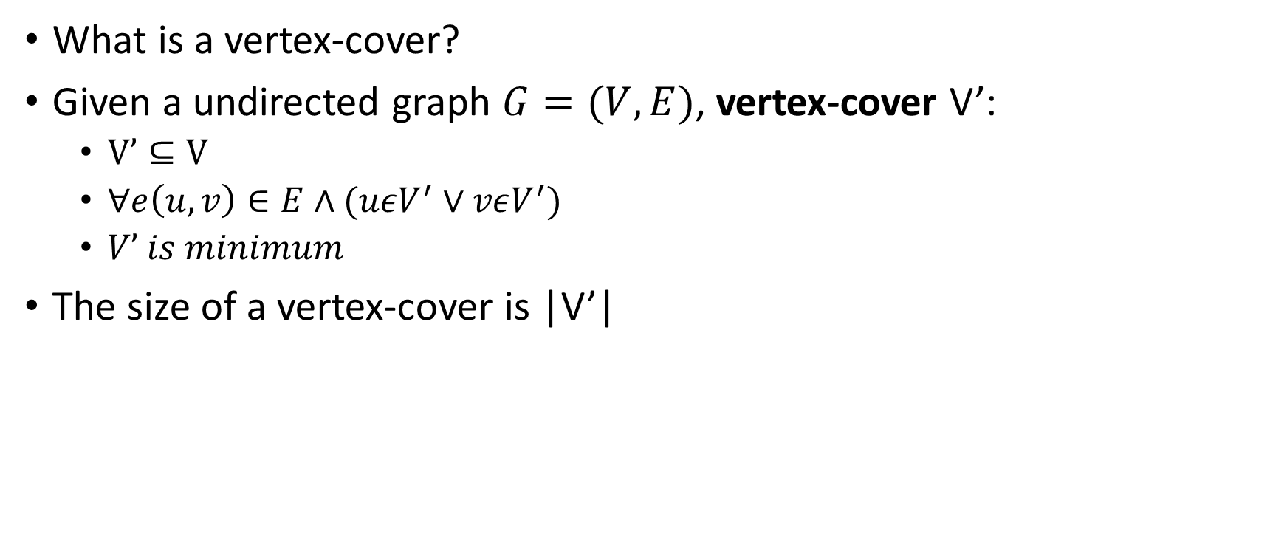
35.1 Vertex-cover problem and a 2-approximation algorithm
What is a vertex-cover?
Given a undirected graph $G=(V, E)$, vertex-cover V’:
$V’⊆V$
$∀e\left(u,v\right)∈E∧(uεV^{′}∨vεV^{′})$
$V’ is minimum$
The size of a vertex-cover is |V’|

Slide 21
Vertex-cover problem and a 2-approximation algorithm
1
2
3
4
5
6
7
Are the red vertices a vertex-cover?
No. why?
Edges (5, 6), (3, 6) and (3, 7) are not covered by it

Slide 22
Vertex-cover problem and a 2-approximation algorithm
1
2
3
4
5
6
7
Are the red vertices a vertex-cover?
No. why?
Edge (3, 7) is not covered by it

Slide 23
Vertex-cover problem and a 2-approximation algorithm
1
2
3
4
5
6
7
Are the red vertices a vertex-cover?
Yes
What is the size?
4

Slide 24
Vertex-cover problem and a 2-approximation algorithm
1
2
3
4
5
6
7
Are the red vertices a vertex-cover?
Yes
What is the size?
7

Slide 25
Vertex-cover problem and a 2-approximation algorithm
1
2
3
4
5
6
7
Are the red vertices a vertex-cover?
Yes
What is the size?
5

Slide 26
Vertex-cover problem and a 2-approximation algorithm
1
2
3
4
5
6
7
Are the red vertices a vertex-cover?
Yes
What is the size?
3

Slide 27
Vertex-cover problem and a 2-approximation algorithm
Vertex-cover problem
Given a undirected graph, find a vertex cover with minimum size.

Slide 28
Vertex-cover problem and a 2-approximation algorithm
1
2
3
4
5
6
7
A minimum vertex-cover

Slide 29
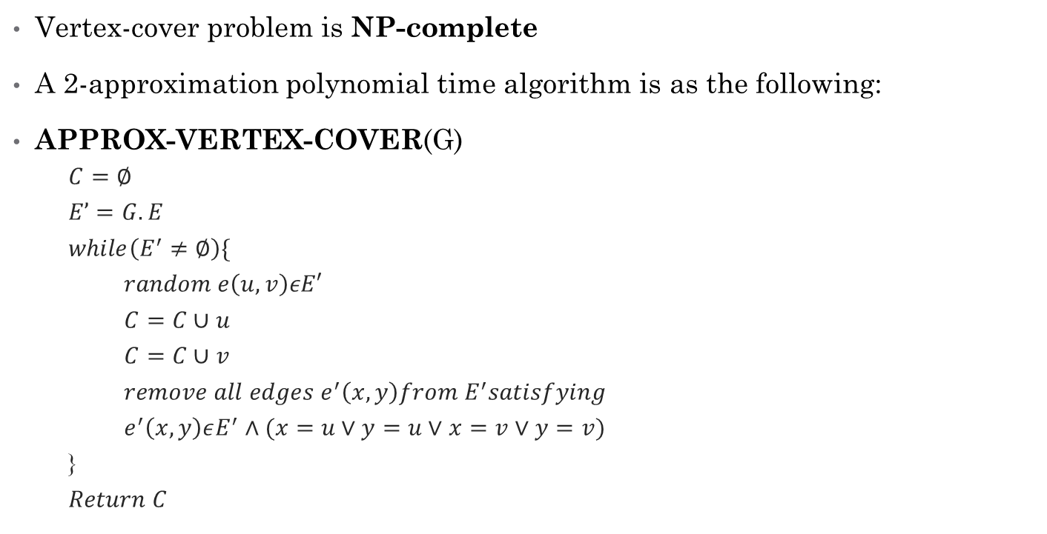
Vertex-cover problem and a 2-approximation algorithm
Vertex-cover problem is NP-complete
A 2-approximation polynomial time algorithm is as the following:
APPROX-VERTEX-COVER(G)
$C=∅$
$E’=G.E$
$while\left(E^{′}≠∅\right)\{$
$random e\left(u,v\right)εE′$
$C=C∪u$
$C=C∪v$
$remove all edges e^{′}\left(x,y\right)from E^{′}satisfying$
$e^{′}\left(x,y\right)εE^{′}∧(x=u∨y=u∨x=v∨y=v)$
}
$Return C$

Slide 30
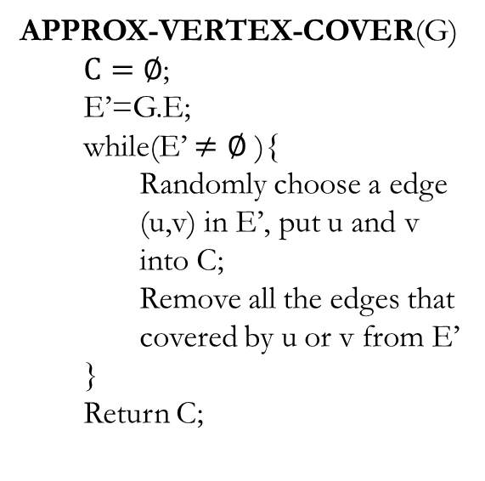
Vertex-cover problem and a 2-approximation algorithm
APPROX-VERTEX-COVER(G)
$C=∅$;
E’=G.E;
while(E’ $≠∅$ ){
Randomly choose a edge (u,v) in E’, put u and v into C;
Remove all the edges that covered by u or v from E’
}
Return C;
1
2
3
4
5
6
7

Slide 31
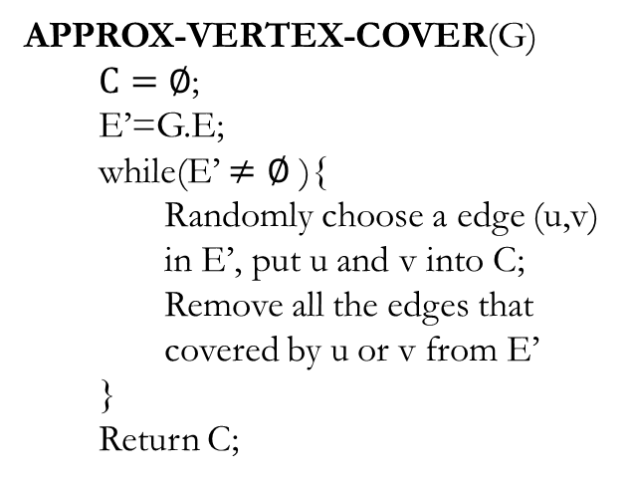
Vertex-cover problem and a 2-approximation algorithm
APPROX-VERTEX-COVER(G)
$C=∅$;
E’=G.E;
while(E’ $≠∅$ ){
Randomly choose a edge (u,v) in E’, put u and v into C;
Remove all the edges that covered by u or v from E’
}
Return C;
1
2
3
4
5
6
7
It is then a vertex cover
Size?
6
How far from optimal one?
Max(6/3, 3/6) = 2

Slide 32
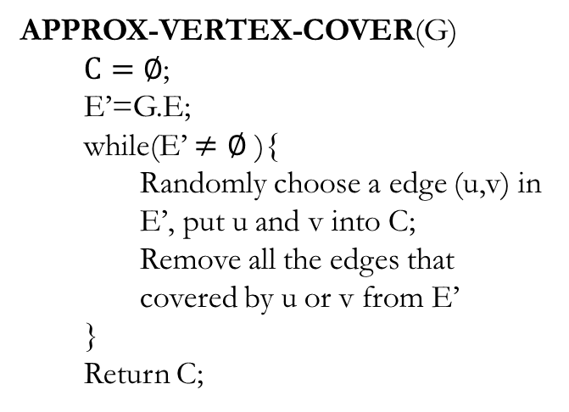
Vertex-cover problem and a 2-approximation algorithm
APPROX-VERTEX-COVER(G)
$C=∅$;
E’=G.E;
while(E’ $≠∅$ ){
Randomly choose a edge (u,v) in E’, put u and v into C;
Remove all the edges that covered by u or v from E’
}
Return C;
1
2
3
4
5
6
7

Slide 33
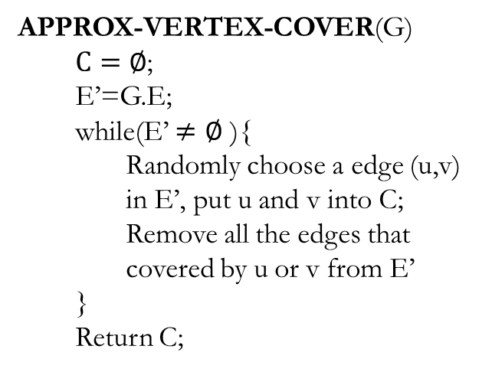
Vertex-cover problem and a 2-approximation algorithm
APPROX-VERTEX-COVER(G)
$C=∅$;
E’=G.E;
while(E’ $≠∅$ ){
Randomly choose a edge (u,v) in E’, put u and v into C;
Remove all the edges that covered by u or v from E’
}
Return C;
1
2
3
4
5
6
7
It is then a vertex cover
Size?
4
How far from optimal one?
Max(4/3, 3/4) = 1.33

Slide 34
Vertex-cover problem and a 2-approximation algorithm
APPROX-VERTEX-COVER(G) is a 2-approximation algorithm
When the size of minimum vertex-cover is s
The vertex-cover produced by APPROX-VERTEX-COVER is at most 2s

Slide 35
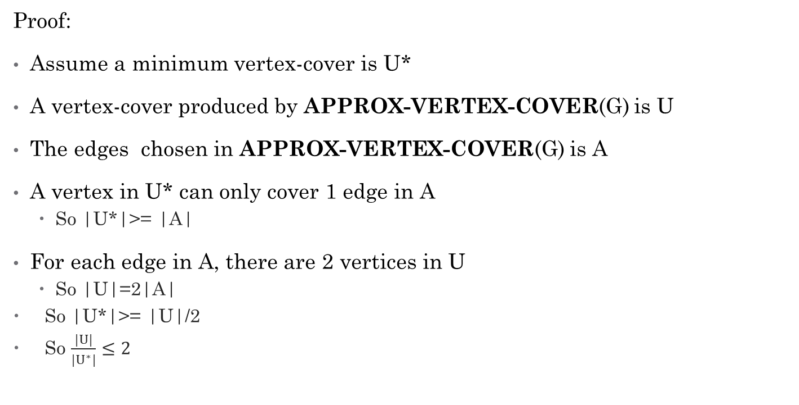
Vertex-cover problem and a 2-approximation algorithm
Proof:
Assume a minimum vertex-cover is U*
A vertex-cover produced by APPROX-VERTEX-COVER(G) is U
The edges chosen in APPROX-VERTEX-COVER(G) is A
A vertex in U* can only cover 1 edge in A
So |U*|>= |A|
For each edge in A, there are 2 vertices in U
So |U|=2|A|
So |U*|>= |U|/2
So $\frac{|U|}{|U^{∗}|}≤2$

Slide 36
35.2 Traveling-salesman problem
Traveling-salesman problem (TSP):
Given a weighted, undirected graph, start from certain vertex, find a minimum route visit each vertices once, and return to the original vertex.
1
1
2
30
2
1
20
3
4
3

Slide 37
Traveling-salesman problem
TSP is a NP-complete problem
There is no polynomial-time approximation algorithm with a constant approximation ratio
Another strategy to solve NPC problem:
Solve a special case

Slide 38
Traveling-salesman problem
Triangle inequality:
Weight(u, v) <= Weight(u, w) + Weight(w, v)
E.g.:
If all the edges are defined as the distance on a 2D map, the triangle inequality is true
For the TSPs where the triangle inequality is true:
There is a 2-approximation polynomial time algorithm

Slide 39
Traveling-salesman problem
APPROX-TSP-TOUR(G)
Find a MST m;
Choose a vertex as root r;
return preorderTreeWalk(m, r);

Slide 40
Traveling-salesman problem
Can we apply the approximation algorithm on this one?
1
1
2
30
2
1
20
3
4
3
No. The triangle inequality is violated.

Slide 41
Traveling-salesman problem
a
d
e
Use Prim’s algorithm to get a MST
b
f
g
c
h
For any pair of vertices, there is a edge and the weight is the Euclidean distance
Triangle inequality is true, we can apply the approximation algorithm

Slide 42
Traveling-salesman problem
a
d
Use Prim’s algorithm to get a MST
e
b
f
g
Choose “a” as the root
c
Preorder tree walk
h
a
b
c
h
d
e
f
g
For any pair of vertices, there is a edge and the weight is the Euclidean distance
Triangle inequality is true, we can apply the approximation algorithm

Slide 43
Traveling-salesman problem
a
d
Use Prim’s algorithm to get a MST
e
b
f
g
Choose “a” as the root
c
Preorder tree walk
h
a
b
c
h
d
e
f
g
Because it is a 2-approximation algorithm
The route is then…
A TSP solution is found, and the total weight is at most twice as much as the optimal one

Slide 44
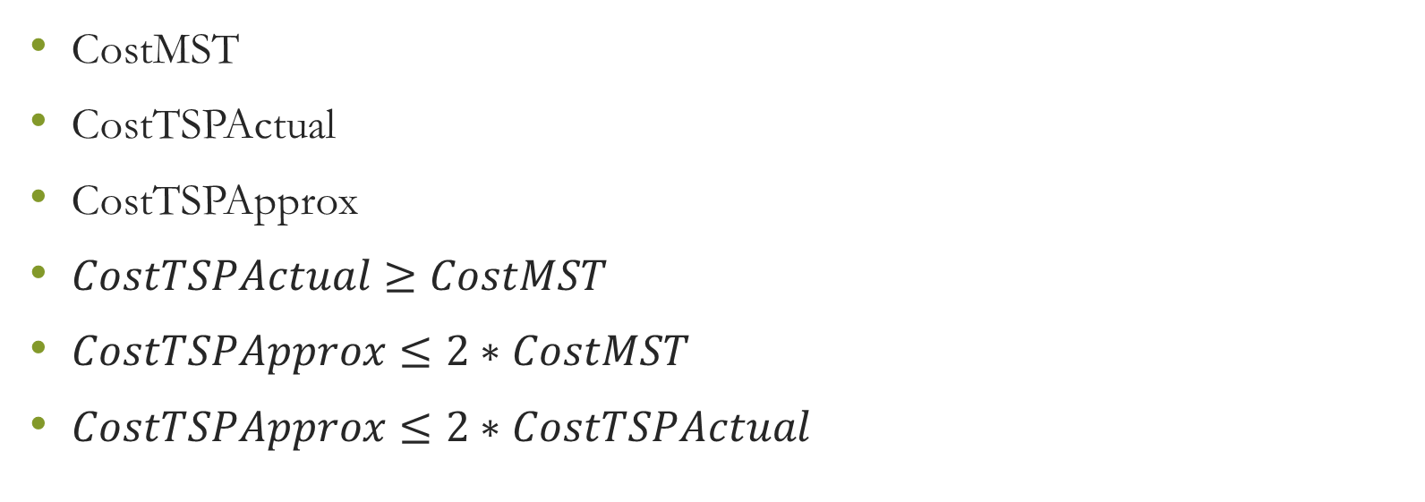
2-Approximate
CostMST
CostTSPActual
CostTSPApprox
$CostTSPActual≥CostMST$
$CostTSPApprox≤2∗CostMST$
$CostTSPApprox≤2∗CostTSPActual$

Slide 45
35.3 The set-covering problem
Set-covering problem
Given a set X, and a family F of subsets of X, where F covers X, i.e. $X=\bigcup_{S∈F}{S}$.
Find a subset of F that covers X and with minimum size

Slide 46
The set-covering problem
X:
a
b
c
h
d
e
{f1, f3, f4} is a subset of F covering X
F:
{f1, f2, f3, f4} is a subset of F covering X
f1:
a
b
f5:
a
{f2, f3, f4, f5} is a subset of F covering X
f2:
b
f3:
c
h
Here, {f1, f3, f4} is a minimum cover set
f4:
d
e

Slide 47
The set-covering problem
Set-covering problem is NP-complete.
If the size of the largest set in F is m, there is a $\sum_{i=1}^{m}{1/i}$ - approximation polynomial time algorithm to solve it.

Slide 48

The set-covering problem
GREEDY-SET-COVER(X, F)
U=X;
C=$∅;$
While(U$≠$ $∅$){
Select S$∈$F that maximizes |S$∩$U|;
U=U-S;
C=C$⋃${S};
}
return C;

Slide 49
The set-covering problem
We can choose from f1, f3 and f4
X:
Choose f1
a
b
c
h
We can choose from f3 and f4
Choose f3
We can choose from f4
d
e
Choose f4
F:
f1:
a
b
a
b
c
h
d
e
U:
f2:
b
f3:
c
h
C:
f1:
a
b
f3:
c
h
f4:
d
e
f4:
d
e
f5:
a

